Slide 1
Hash Table

Slide 2
Hash Table
Hash Table is a data structure which stores data in an associative manner.
In a hash table, data is stored in an array format, where each data value has its own unique index value.
Access of data i.e. insertion and search operation becomes very fast if we know the index of the desired data.

Slide 3
Hash Table
Hash Table uses an array as a storage medium
Uses hash technique to generate an index where an element is to be inserted or is to be located from.

Slide 4


Hashing Technique
convert a range of values into a range of indexes of an array.
Use modulo operator to get a range of key values. Consider an example of hash table of size 11, and the following items are to be stored.

Slide 5
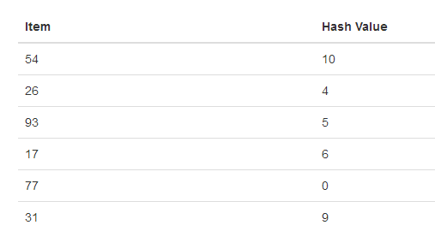

Hash function

Slide 6
Linear Probing
it may happen that the hashing technique is used to create an already used index of the array.
In such a case, we can search the next empty location in the array by looking into the next cell until we find an empty cell.
This technique is called linear probing.

Slide 7

Linear Probing
(54,26,93,17,77,31,44,55,20)

Slide 8
Basic Operations
Following are the basic primary operations of a hash table.
Search − Searches an element in a hash table.
Insert − inserts an element in a hash table.
delete − Deletes an element from a hash table.

Slide 9
Insert Operation
Whenever an element is to be inserted, compute the hash code of the key passed
locate the index using that hash code as an index in the array.
Use linear probing for empty location, if an element is found at the computed hash code.

Slide 10
Delete Operation
Whenever an element is to be deleted, compute the hash code of the key passed and locate the index using that hash code as an index in the array.
Use linear probing to get the element ahead if an element is not found at the computed hash code.
When found, store a dummy item there to keep the performance of the hash table intact.

Slide 11
Search Operation
Whenever an element is to be searched, compute the hash code of the key passed and locate the element using that hash code as index in the array.
Use linear probing to get the element ahead if the element is not found at the computed hash code.

